Slide 1
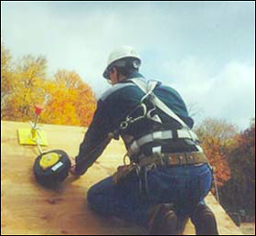
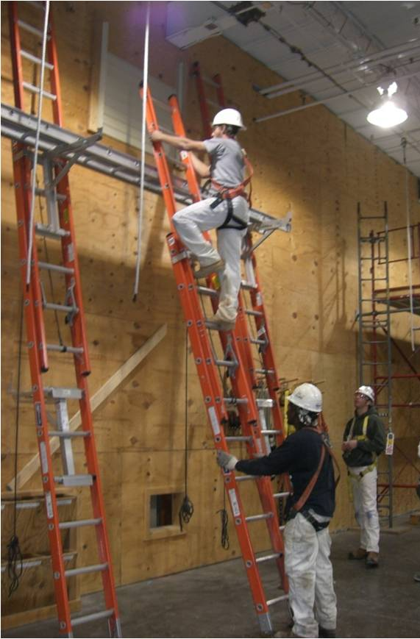
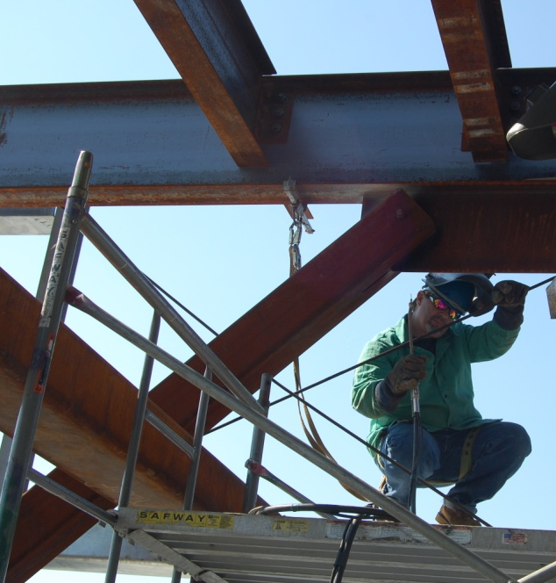

Slide 2
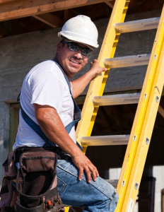
Agenda
Welcome
Webinar Goals
NIOSH Update
OSHA Update
CPWR Update
Q & A
Next Webinar

Slide 3
NIOSH Ladder Safety Smart Phone App
Presented by Christine M. Branche, Ph.D., FACE
National Institute for Occupational Safety and Health

Slide 4
NIOSH Ladder Safety Smart Phone App
Provides a tool to quickly and easily adjust the ladder at a safer angle
Provides quick and easy access to ladder safety information, guidelines, and checklists on ladder selection, inspection, accessorizing and use

Slide 5
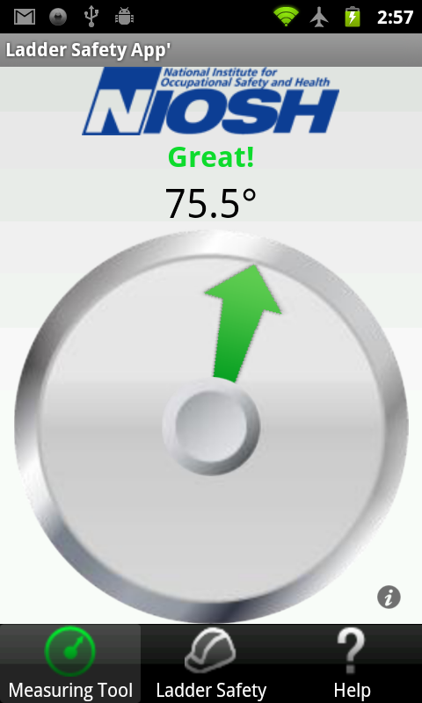
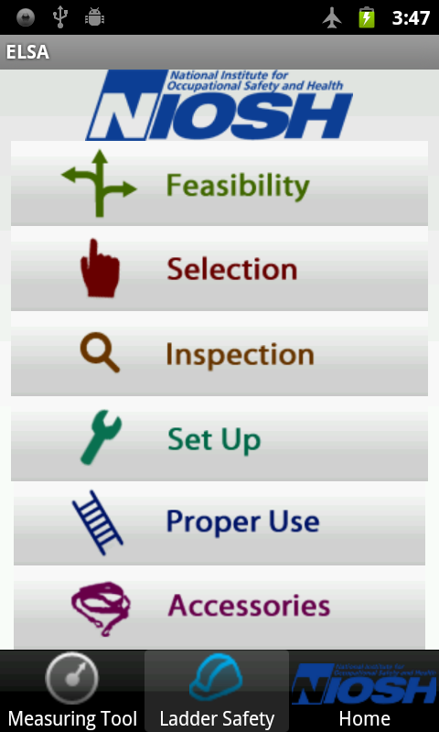
NIOSH Ladder Safety Smart Phone App
Measuring Tool
Research and Training Tool

Slide 6
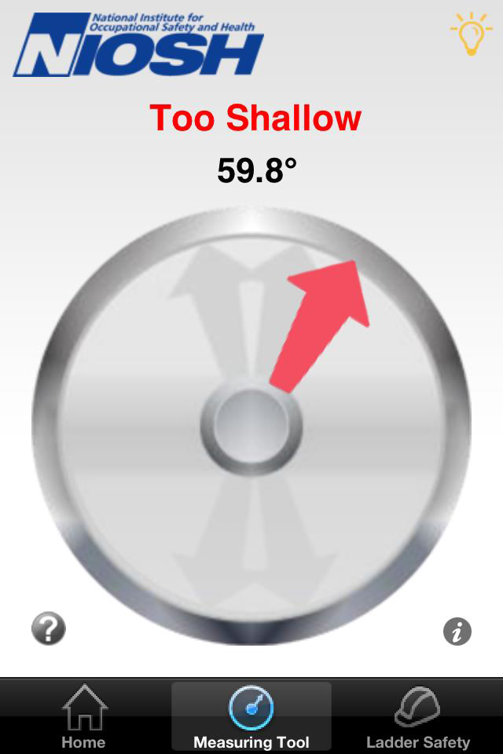
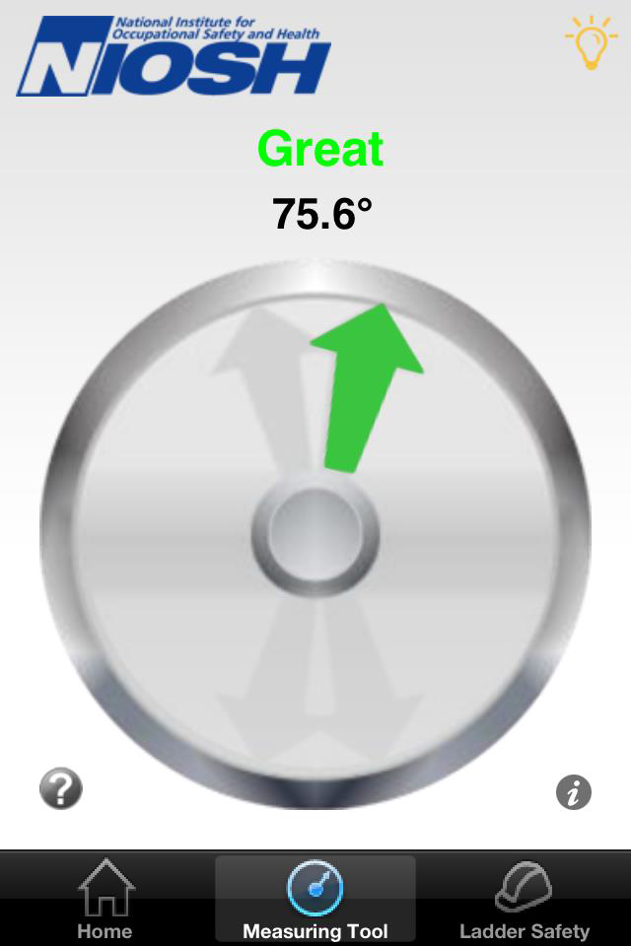
Measuring Tool
A constant tone along with a visual indication (green arrow) indicates a “good” notice when the angle is in the range of ±2 degrees from 75.5 degrees.

Slide 7
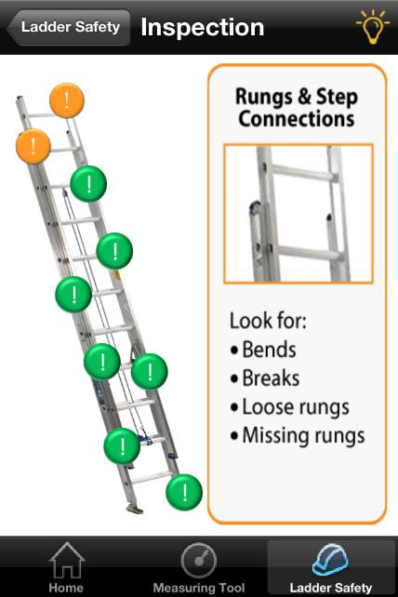
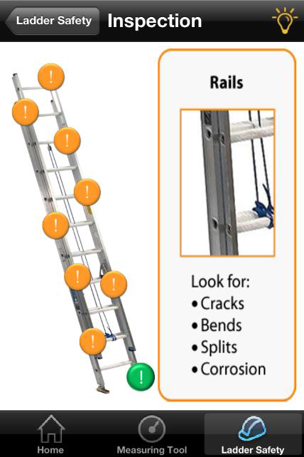
Inspection Tool
As the user rolls over each button, an enlarged image and a brief description of the types of damage to look for appears. The color of the viewed button will change.

Slide 8
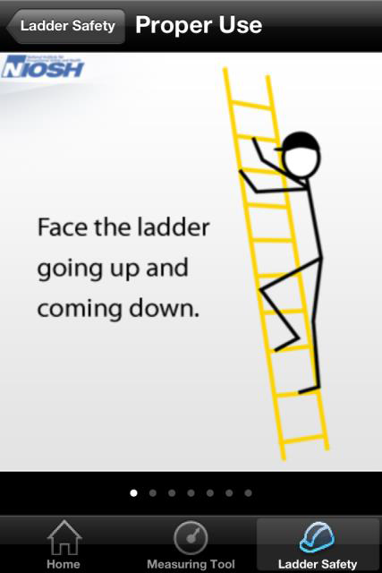
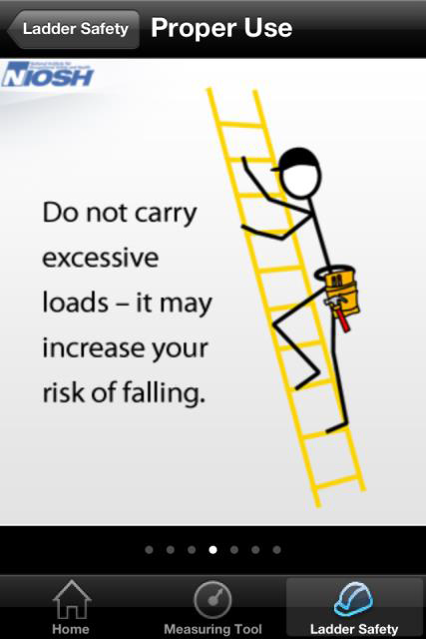
Proper Use Tool
Standard-recommended safety practices are schematically displayed. To view all of the images, swipe the page.

Slide 9
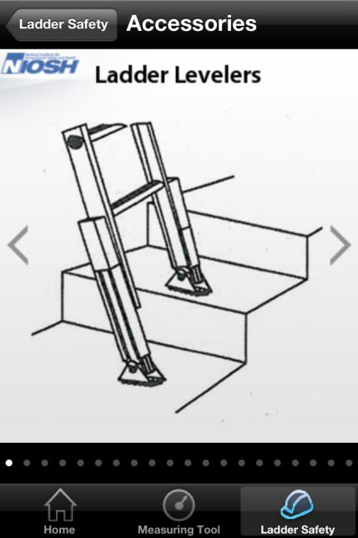
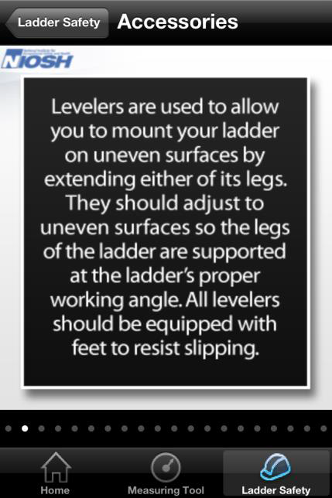
Accessories Tool
Ladder accessories with brief description of intended use are displayed. View all images by swiping the page.

Slide 10
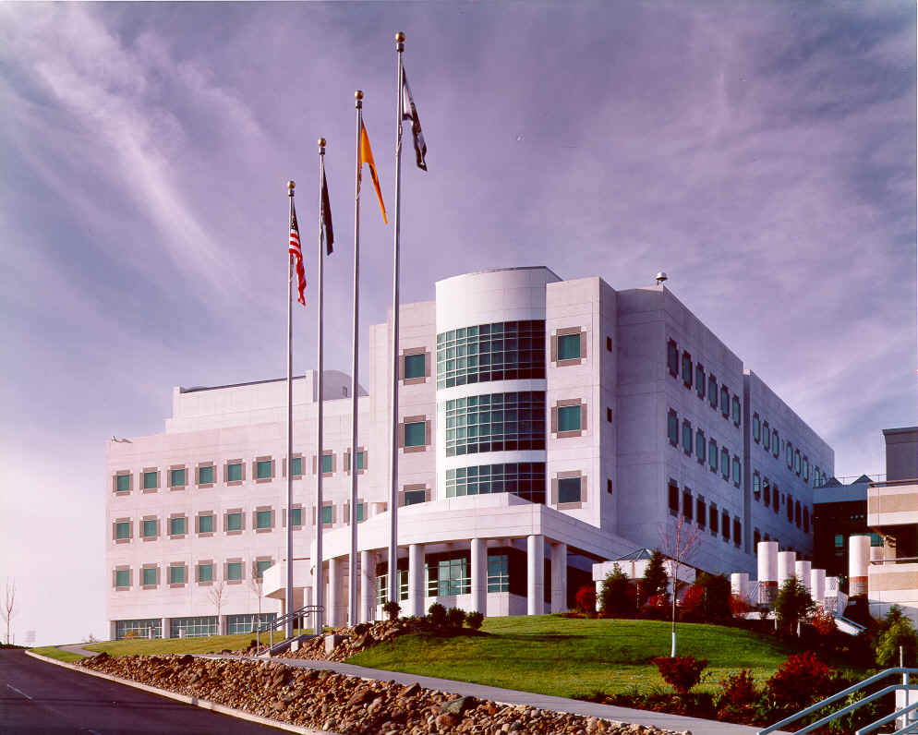
Contact information:
Peter Simeonov, Ph.D.
E-mail: psimeonov@cdc.gov
Tel: 304-285-6268
Division of Safety Research, NIOSH

Slide 11
Thank you!
Christine Branche
NIOSH
Principal Associate Director
Director, Office of Construction Safety and Health
Construction Program Manager
202-245-0625|cbranche@cdc.gov
NIOSH Directory of Construction Resources
www.cdc.gov/niosh/construction/
Twitter
http://twitter.com/NIOSHConstruct
The findings and conclusions in this presentation have not been formally disseminated by the National Institute for Occupational Safety and Health and should not be construed to represent any agency determination or policy.

Slide 12
2013 Fall Prevention Campaign
www.osha.gov/stopfalls

Slide 13
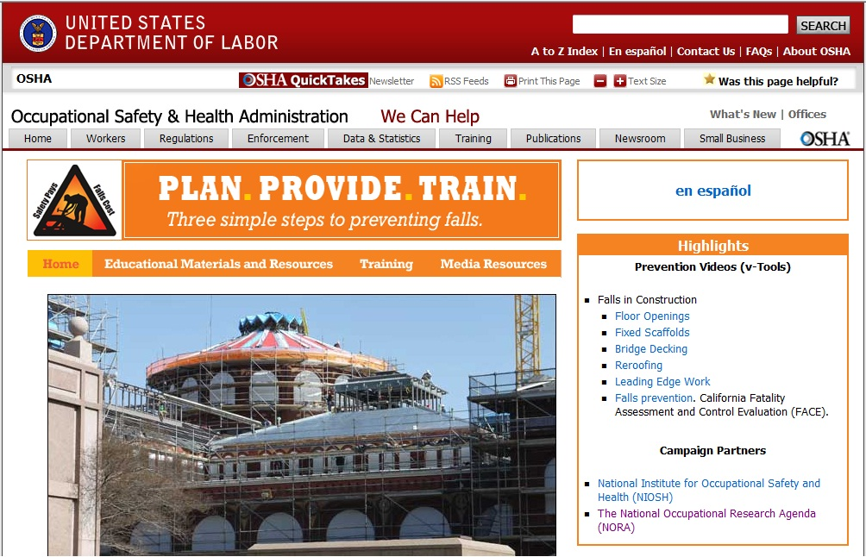
Campaign Website
Notes:
Like NIOSH and CPWR, OSHA has a webpage dedicated to fall prevention too. This is our lead in page for the fall prevention campaign and can be found at http://www.osha.gov/stopfalls/
Visits and Views – Over 500,000 to our fall prevention website
A little history on what OSHA Field and Consultation Projects have done.
Regional and Area Office Outreach for Fall Prevention in Construction
From April 26, 2012 thru the First Quarter 2013, OSHA Regional and Area Offices conducted over 2750 outreach activities related to fall prevention.
Media Events
Phone Banks
TV and Radio Interviews
Magazine articles
Speeches
Training sessions
Safety Conference participation
Consultation Projects Residential Construction Fall prevention Outreach
In FY 2012 thru the First Quarter of 2013 OHSA’s Consultation Projects Conducted
3,821 onsite visits
546 presentations
1156 training sessions
Total all consultation activities = 5,523

Slide 14
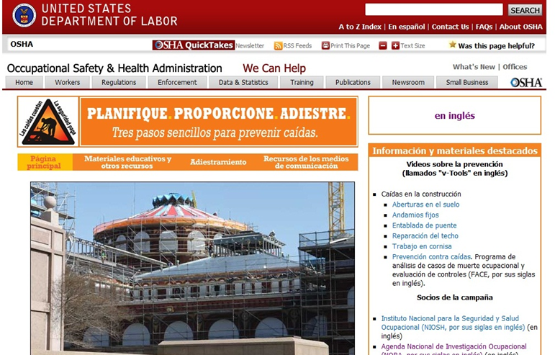
Campaign Website
…en Español

Slide 15
Mining OSHA’s Fall Prevention Webpages
Residential Construction Fall Prevention
Fact Sheets
Installing Standing Seam Metal Roofs
Re-Roofing
Roof Sheathing
Working in Attics
Erecting Exterior and Interior Walls
Floor Joist and Decking Installation
Videos
Fall Protection: Roofing. Washington State Video.
Fall Protection: Trusses. Washington State Video.
Web Links - Examples
Massachusetts Health and Human Services – Fall Protection for Construction
American Ladder Institute
OSHA Alliance Tool Box Talks on Falls i.e. Arial Devices, Personal Fall Protection Devices
Now Available in Spanish
Notes:
Examples of our residential outreach include a series of fact sheets topics:
Installing Standing Seam Metal Roofs
Re-Roofing
Roof Sheathing
Working in Attics
Erecting Exterior and Interior Walls
Floor Joist and Decking Installation

Slide 16
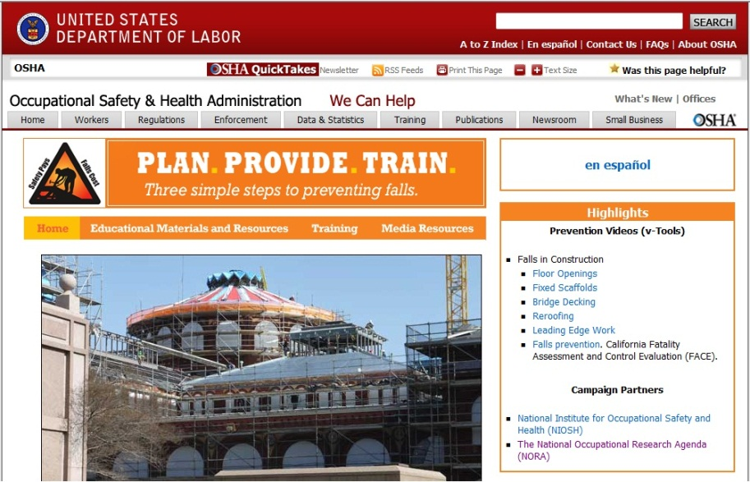
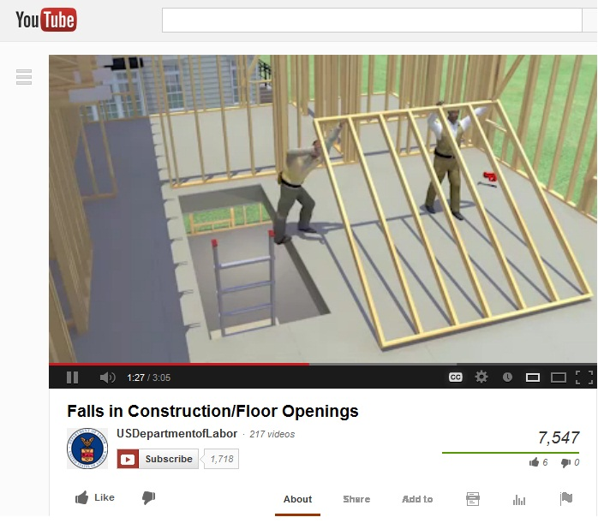
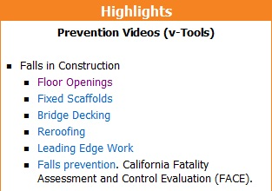
Training Tools
CLICK TO WATCH
Notes:
OSHA has 6 animated videos related to fall prevention.
Rave reviews
We encourage use
Available OSHA’s Web Site or You Tube.
Smart Phone and Tablet Friendly
How to get there! - Google “OSHA Fall Prevention Videos”

Slide 17
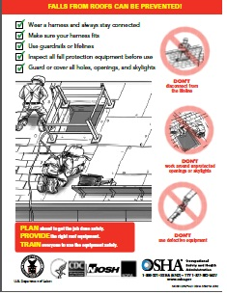
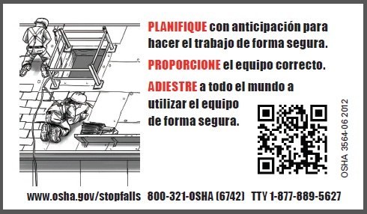
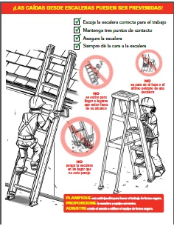
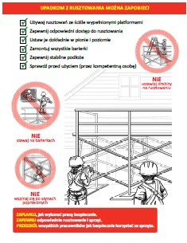
Educational Materials
Wallet Cards, Tool Box Stickers, and more coming soon…
Posters in English
and Spanish
Fact sheets in English, Spanish, Polish, Russian and Portuguese
Notes:
Over 400,000 documents Distributed

Slide 18
2013 CONSTRUCTION FALL PROTECTION PRODUCTS
Fact Sheets
Extension Ladders
Step/A-frame ladders
Job-made Ladders
Singapore – “Falling Off Ladders Can Kill”
Nearing Completion
Narrow Frame Scaffolds (Baker/Perry)
Tube and Coupler Scaffold
Revision of Publication 3146 - Subpart M – Fall Protection in Construction
Roofing safe work practices
Notes:
Construction Fall Protection Projects - Under Consideration
Tool Box Safety Talks on Fall Hazards Examples:
How to Install an Anchorage System
How to Inspect a Personal Fall Arrest systems
How to safely climb an extension ladder
Consideration to expand the campaign to include additional fall hazard issues.
Slips and falls
Falls from equipment
Falls from structural steel
Falls from leading edge
Falls through floor openings
Falls down stairwells
Products DOC is working on:
Rewrite of 1998 Subpart M - Fall Protection guidance document
Roofing safe work practices
Video from the State of Washington (Residential Construction Techniques for preventing falls)
Miscellaneous English to Spanish translations for video and outreach products
Construction Fall Protection Projects - Under Consideration
Tool Box Safety Talks on Fall Hazards Examples:
How to Install an Anchorage System
How to Inspect a Personal Fall Arrest systems
How to safely climb an extension ladder
Consideration to expand the campaign to include additional fall hazard issues.
Slips and falls
Falls from equipment
Falls from structural steel
Falls from leading edge
Falls through floor openings
Falls down stairwells

Slide 19
New Fact Sheets

Slide 20
New Training Guide

Slide 21
New Mobile Features
New smartphone-accessible version of the Fall Campaign webpage.
Features easy-to-view resources for any mobile device.

Slide 22
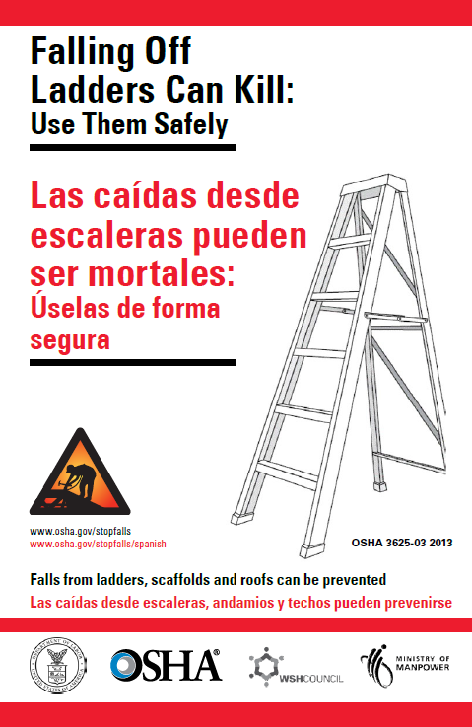
New Mobile Features
New bilingual English-Spanish booklet about using ladders safely.
Can be read on any mobile device using a free e-reader.
Notes:
Available for view on the smart phone with other Fall Prevention Material.

Slide 24
Campaign Web Page

Slide 25
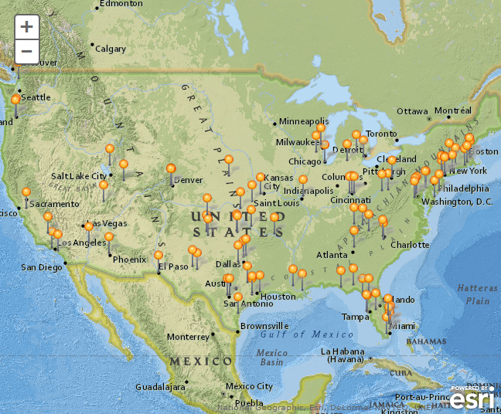
Fatality Map for 2013
Fatality and Fatal Falls maps are now posted for the first quarter of 2013

Slide 26
New guide available for partners of the Campaign to Prevent Falls in Construction

Slide 27
Homeowners Guide
Short flyer to educate homeowner’s on how to ask safety questions of contractors
Also available in Spanish

Slide 28
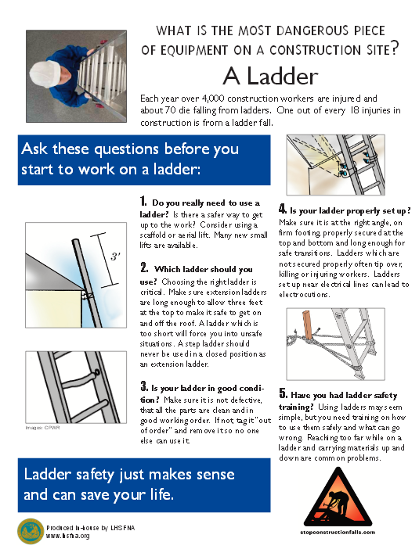
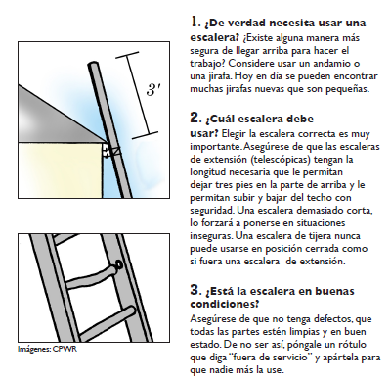
Ladder Safety Checklist
Now available in Spanish

Slide 29
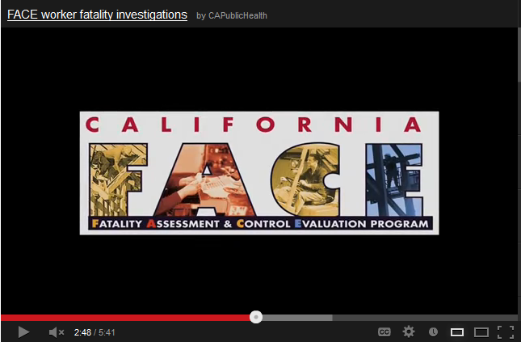
CA FACE Video
This video explains the events that led to a roofing supervisor's death after he fell 30 feet through a warehouse roof skylight onto a floor.
Notes:
If you click the image of the youtube box in presentation mode, it will lead to the video

Slide 30
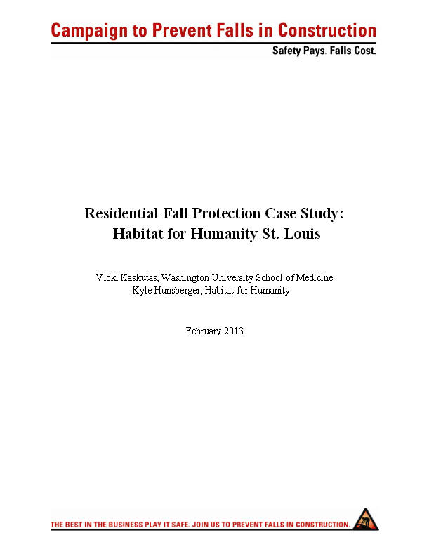
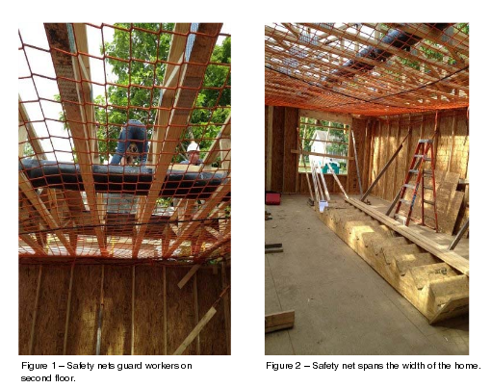
Case Study from Habitat for Humanity

Slide 31
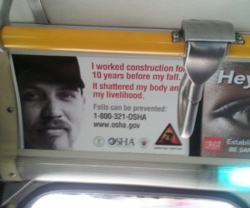
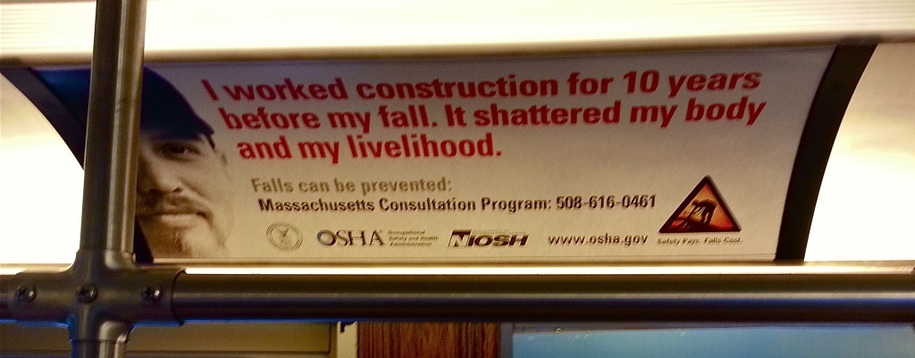
Mass Transit and the Campaign
Advertisement from Montgomery County, MD Ride On Bus
Advertisement from Massachusetts Public Transit

Slide 32
Fall Prevention Campaign –
Our Messages
PLAN ahead to get the job done safely
PROVIDE the right equipment
TRAIN everyone to use the equipment safely

Slide 33
Fall Prevention Campaign –
Contact Information
Website: www.stopconstructionfalls.com
For Campaign information, to report your partner activities, or assistance, email falls@cpwr.com
To report a fatality in construction for 2013, email fatalitymap@cpwr.com

