Slide 1
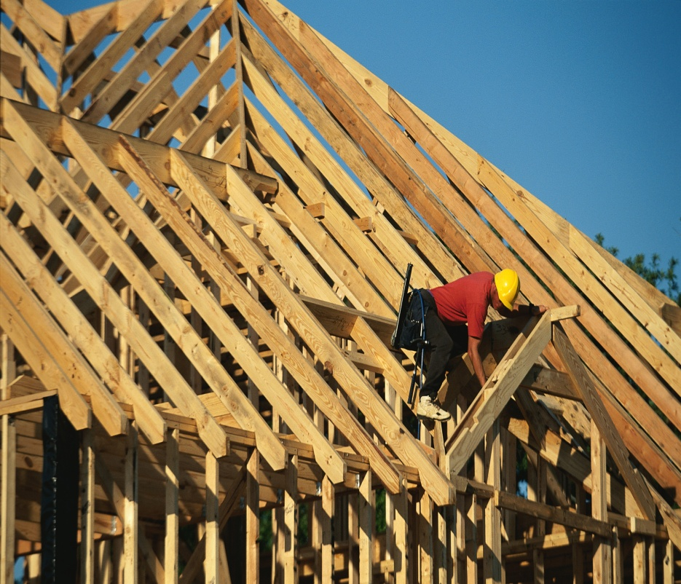
Safety Pays. Falls Cost. Preventing Falls in Construction
Christine M. Branche, Ph.D., FACE
National Institute for Occupational Safety and Health
August 16, 2012
OHS Webcast
The findings and conclusions in this presentation have not been
formally disseminated by the National Institute for Occupational Safety and Health
and should not be construed to represent any agency determination or policy
Notes:
Give a little background about NORA and the NORA Construction Sector Council

Slide 2
Construction Fall Prevention Campaign Goal
To provide small residential construction contractors/owners the information, motivation, and support they need to create the necessary conditions for their workers to work safely at heights.
Notes:
Acknowledge Dr. Janie Gittleman and Scott Schneider as co-chairs of the campaign effort within the NORA Construction Sector Council.

Slide 3
Values
Evidence-based campaign
NORA Construction Sector Council-led
Evaluation essential to demonstrate success

Slide 4
Why a Focus on Falls?
The largest fall fatality hazards:
Roofs ~1/3rd
Scaffolds ~16%
Ladders ~16%
These 3 issues combined account for roughly 2/3 of all fatal falls in construction
Notes:
Data is from BLS CFOI– these proportions are very stable over time so no particular year is indicated.

Slide 5
Construction Fall Fatalities
 | 2008 | 2009 | 2010
Total Number of Construction Fatalities | 975 | 834 | 774
Falls to lower level | 328 | 276 | 255
Fall from roof | 100 | 86 | 90
Fall from Scaffold | 52 | 41 | 37
Fall from Ladder | 66 | 74 | 68
Source: BLS CFOI Data
Notes:
Why we need a fall prevention campaign for construction.
FALLS ARE THE LEADING CAUSE OF DEATH IN CONSTRUCTION. In 2010, there were 255 fall fatalities and 10,000 injuries. Falls have consistently accounted for about 1/3 of fatalities in construction These injuries and deaths are preventable.
The fall prevention campaign focuses on raising employee awareness of common fall hazards in construction with the message Safety Pays - Falls Cost, and how falls from roofs, ladders, scaffolds (the three leading causes of fall fatalities in construction) can be prevented and lives can be saved through three simple steps for contractors: Plan, Provide and Train.
PLAN ahead to get the job done safely.
PROVIDE the right equipment
TRAIN everyone to use the equipment safely
Note: Falls from roofs, ladders and scaffolds accounted for approximately 74% of all fall fatalities in 2010

Slide 6
Most Frequently Cited Serious Violations in Construction
Fall protection – Residential construction 6’ or more
Portable ladders 3 feet above landing surface
Fall protection - Unprotected sides & edges
Head protection
Standard & Subpart - 1926.
Fall hazards training program
Eye & face protection
Aerial Lifts - Body belt and lanyard
Scaffolds - Fall protection
Scaffolds - Access
Scaffolds - Platform construction

Slide 7
Intended Audience
Primary: Small residential construction contractors
Secondary: Supervisors and foremen for these contractors
Tertiary: Workers for these contractors, including Spanish speakers

Slide 8
Construction Falls Prevention Campaign
National in scope
Launched on Workers’ Memorial Day 2012
by DOL Secretary Hilda Solis
Two-year span
Focused on falls from roofs, scaffolds, ladders

Slide 9
Web Addresses
Main campaign website (National Construction Center) http://www.stopconstructionfalls.com
Facebook www.facebook.com/pages/Stop-Construction-Falls/215070198597124
Campaign posters and fact sheets
http://www.osha.gov/stopfalls/
http://www.cdc.gov/niosh/construction/stopfalls.html
NIOSH Science blog http://blogs.cdc.gov/niosh-science-blog/
Fatality Assessment and Control Evaluation Program (FACE) reports http://www.cdc.gov/niosh/face/
To become involved in the campaign: email falls@cpwr.com
Notes:
CPWR—The Center for Construction Safety and Health, Pete Stafford is the executive director.
Posters can be ordered for free through the OSHA website.

Slide 10
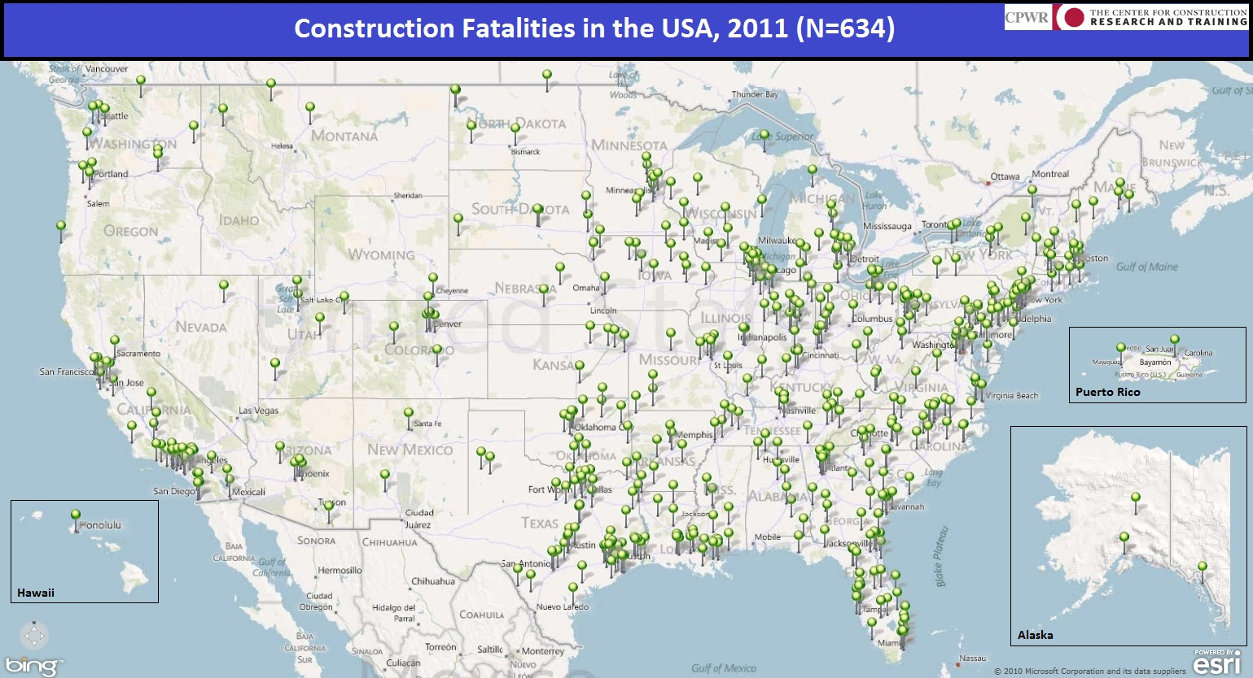
In January of 2011, CPWR - The Center for Construction Research and Training began collecting data on occupational fatalities in the construction industry as part of a national fall prevention campaign. Surveillance is continuing on an annual basis, and data is currently being collected for calendar year 2012. The purpose of this mapping project is to identify construction fatalities occurring annually in the U.S. and provide a visual representation of the scope, magnitude, and geographic distribution of these deaths.
Notes:
All construction deaths, not just from falls.

Slide 11
NIOSH Directory of Construction Resources
http://www.cdc.gov/niosh/construction/
Twitter
http://twitter.com/NIOSHConstruct
Christine Branche
NIOSH Construction Program Manager|202-245-0625|cbranche@cdc.gov
The findings and conclusions in this presentation have not been formally disseminated by the National Institute for Occupational Safety and Health and should not be construed to represent any agency determination or policy.

Slide 12
Directorate of Construction OH&S Webinar Fall Prevention Campaign Update 08/16/2012
Jim Maddux - Director
Directorate of Construction
Notes:
12

Slide 13
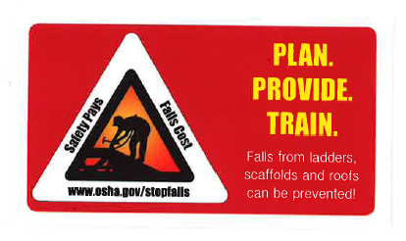
Fall Prevention Campaign Update
Poster
Tool Box Stickers
Pocket Cards
Front
l Construction Fact Sheets
Back

Slide 14
FACT SHEET
Notes:
50,000 Fact Sheets distributed

Slide 18
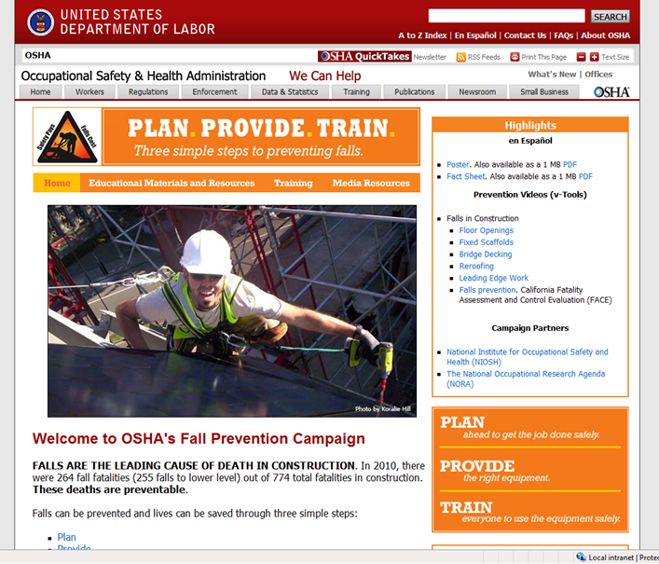
http://www.osha.gov/stopfalls
New Training Tab
Notes:
New Training tab -
JM Note: Web Address to follow on Slide # 22

Slide 19
OSHA Directorate of Construction Website
Fact Sheets
Installing Standing Seam Metal Roofs
Re-Roofing
Roof Sheathing
Installing Roof Trusses
Installing Tile Roofs
Roof Repair
New - Working in Attics
New - Erecting Exterior and Interior Walls
New - Floor Joist and Decking Installation

Slide 20
Construction Fall Protection Products Under Development
Misc.:
Rewrite of 1998 Publication Subpart M - Fall Protection guidance document
Roofing safe work practices
Video from the State of Washington (Residential Construction Techniques)
Miscellaneous English to Spanish translations for video and outreach products
Fact Sheets
Extension Ladders
Step/A Frame ladders
Job Made Ladders
Narrow Frame Scaffolds (Baker/Perry)
Tube and Coupler Scaffold
Pump Jack Scaffold

Slide 21
Fall Prevention Field Activity
Regional and Area Offices
357 fall prevention outreach activities since the Fall Prevention Campaign launch on April 26, 2012
In first three quarters FY 2012 conducted 809 outreach activities related to fall protection in residential construction
Consultation
In first three quarters FY 2012 On-site visits – 2,527 related to fall protection in residential construction
925 Training sessions
438 presentations

Slide 22
Training
Education Centers
Course# 3110 Fall Arrest Systems
Principles of Fall Protection
Fall Protection Components
Limitations
Field Exercise/Hands on
Course #7405 – Fall Hazard Awareness for the Construction Industry
Identify, Prevent, or Control Fall Hazards at Construction Sites
Susan Harwood Grants
Numerous training and developmental grants includes fall protection topics :
http://www.osha.gov/dte/sharwood/grantawards.htm
OSHA Fall Prevention Webpage
Training Resources for fall protection and prevention (Tab on site)
http://www.osha.gov/stopfalls/trainingresources.html

Slide 23
Contact Information
Jim Maddux, Director
Directorate of Construction
Maddux.jim@dol.gov
202 693-2020

